Slide 1



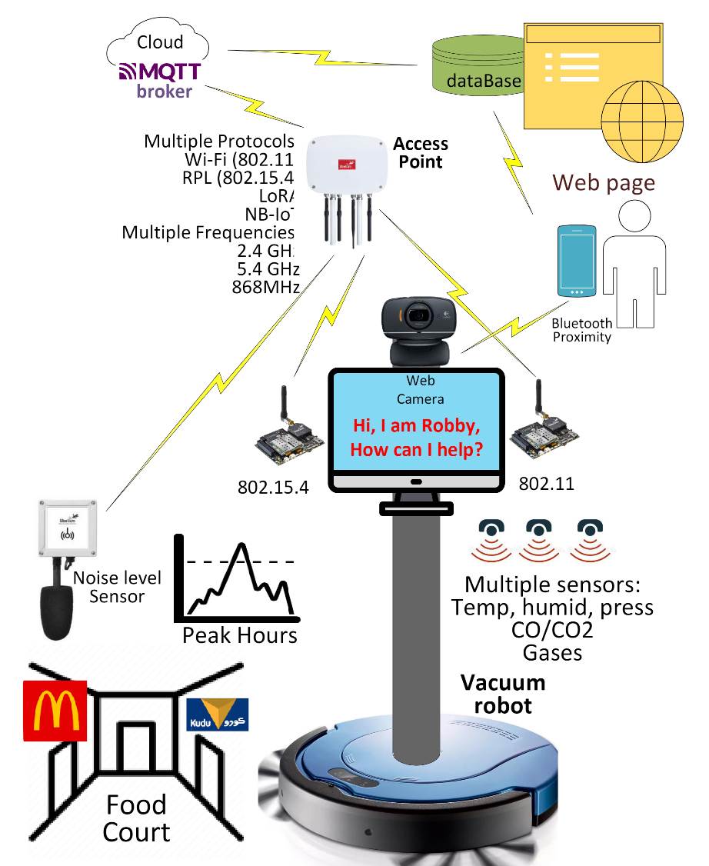

Intelligent Hoover as an IoT solution
Team Information
Mohammed Abuhaimed
Nawaf Alzahem
Khalid Abu Alsaud
Fahad Aldulaigan
Khalid Ali Hali
Supervised by
Dr.George Violettas
Project Overview
Project Requirement
Project Design
Project Brief:
The system that is being developed is the AI vacuum cleaner powered by IoT services and sensors from libelium. Its main goal is to provide an ease of use and lead digital revolution of domestic life in order to:
Use biometrics to provide an ease of accessibility and an authenticated system.
Utilize an AI-powered engine and libelium systems for the consumers to purchase at the optimal price.
Effortlessly command with accurate results
Approach:
Coded using c and python
Developed on waspmote libraries
Use of libelium sensors
Providing a device for:
Acquire the best cleaning services which will be used by students, admin, staff, and faculty.
Introducing functionalities of biometrical recognition features which would allow facial and voice recognition abilities.
System Overview
Implement open-source libraries to achieve voice and facial recognition.
Collect data of new facial and voice recognition for the system to analyze.
Integrate the raspberry pi system into the vacuum hoover solution.

